Slide 1
3D 연습

Slide 2
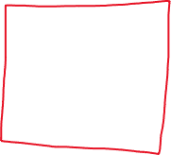
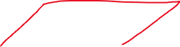

3D도형 vertex 만들기
float[] vertices = { -1.0f, -1.0f, -1.0f, 1.0f, -1.0f, -1.0f, 1.0f, 1.0f, -1.0f, -1.0f, 1.0f, -1.0f, -1.0f, -1.0f, 1.0f, 1.0f, -1.0f, 1.0f, 1.0f, 1.0f, 1.0f, -1.0f, 1.0f, 1.0f, }; short[] indices = { 0, 1, 3, 3, 1, 2, 0, 1, 4, 4, 5, 1, 1, 2, 5, 5, 6, 2, 2, 3, 6, 6, 7, 3, 3, 7, 4, 4, 3, 0, 4, 5, 7, 7, 6, 5 };

Slide 3



FloatBuffer vb = ByteBuffer.allocateDirect(vertices.length * 4).order(ByteOrder.nativeOrder()).asFloatBuffer(); vb.put(vertices); vb.position(0); ShortBuffer ib = ByteBuffer.allocateDirect(indices.length * 2).order(ByteOrder.nativeOrder()).asShortBuffer(); ib.put(indices); ib.position(0);
int[] buffers = new int[2]; GLES20.glGenBuffers(2, buffers, 0); vBuffer = buffers[0]; GLES20.glBindBuffer(GLES20.GL_ARRAY_BUFFER, vBuffer); GLES20.glBufferData(GLES20.GL_ARRAY_BUFFER, vertices.length * 4, vb, GLES20.GL_DYNAMIC_DRAW); GLES20.glBindBuffer(GLES20.GL_ARRAY_BUFFER, 0); iBuffer = buffers[1]; iLength = indices.length; GLES20.glBindBuffer(GLES20.GL_ELEMENT_ARRAY_BUFFER, iBuffer); GLES20.glBufferData(GLES20.GL_ELEMENT_ARRAY_BUFFER, iLength * 2, ib, GLES20.GL_DYNAMIC_DRAW); GLES20.glBindBuffer(GLES20.GL_ELEMENT_ARRAY_BUFFER, 0);

Slide 4
그리기
GLES20.glBindBuffer(GLES20.GL_ELEMENT_ARRAY_BUFFER, iBuffer); GLES20.glDrawElements(GLES20.GL_TRIANGLES, iLength, GLES20.GL_UNSIGNED_SHORT, 0); GLES20.glBindBuffer(GLES20.GL_ELEMENT_ARRAY_BUFFER, 0);

Slide 5
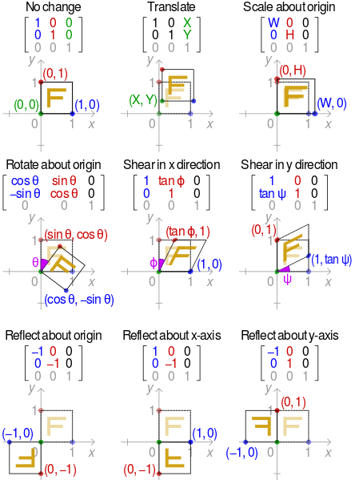
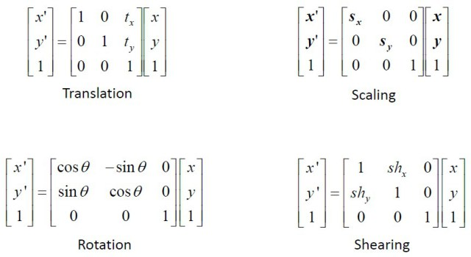
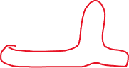
변환행렬
homogeneous coordinate << 검색

Slide 6
Scale matrix
float[] scaleMX = { 0.5f, 0.0f, 0.0f, 0.0f, 0.0f, 0.5f, 0.0f, 0.0f, 0.0f, 0.0f, 0.5f, 0.0f, 0.0f, 0.0f, 0.0f, 1.0f };

Slide 7
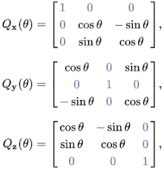


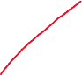
Rotation matrix
float[] rotatexMX = { 1.0f, 0.0f, 0.0f, 0.0f, 0.0f, (float) Math.cos(time), (float) Math.sin(time), 0.0f, 0.0f, -(float) Math.sin(time), (float) Math.cos(time), 0.0f, 0.0f, 0.0f, 0.0f, 1.0f };
Matrix.rotateM(modelMX, 0, time, 1, 0, 0); // 이런 식으로도..

Slide 8



Translation matrix
1
0
1
0
1
1
0
0
1
float[] transMX = { 1.0f, 0.0f, 0.0f, 0.0f, 0.0f, 1.0f, 0.0f, 0.0f, 0.0f, 0.0f, 1.0f, 0.0f, (float) Math.cos(time), (float) Math.sin(time), 0.0f, 1.0f };

Slide 9
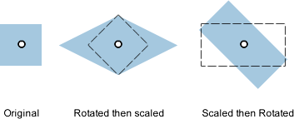
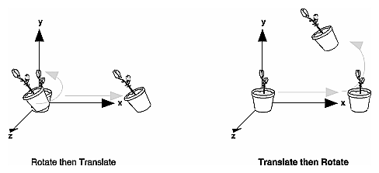

Slide 10
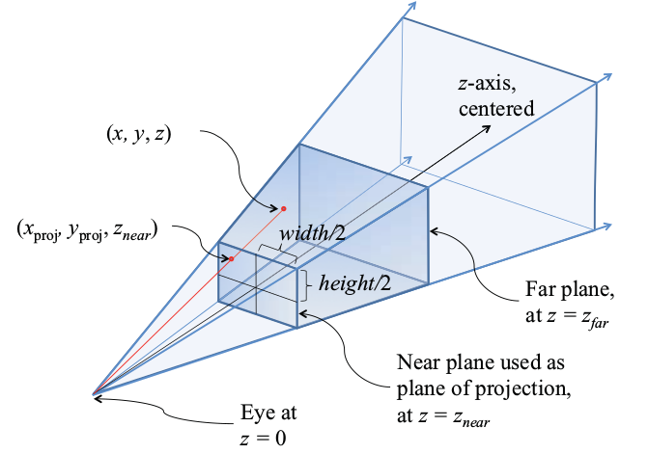

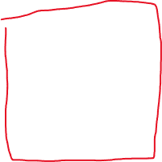

Projection matrix
float aspect = (float) (width) / (float) (height); float[] projMX = new float[16]; Matrix.frustumM(projMX, 0, -aspect, aspect, -1, 1, 1.0f, 100.0f); pos = GLES20.glGetUniformLocation(program, "projMX"); GLES20.glUniformMatrix4fv(pos, 1, false, projMX, 0);

Slide 11
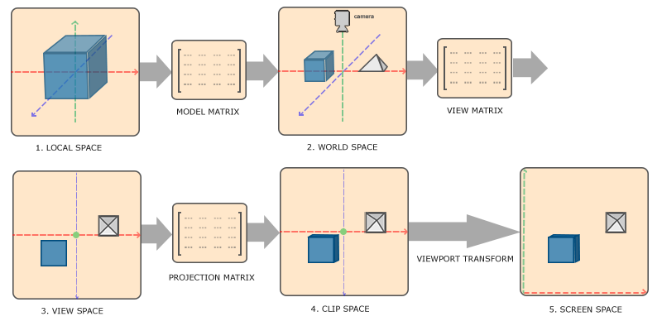

Slide 12







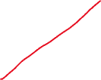


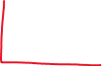


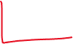

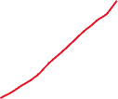

View matrix

Slide 13
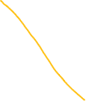
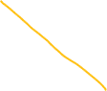


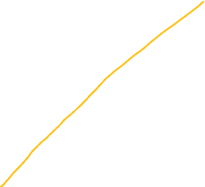

Slide 14

(up)
(center)
(eye)
Matrix.setLookAtM(viewMX, 0, eyex, eyey, eyez, centerx, centery, centerz, upx, upy, upz);
float[] viewMX = new float[16]; float eyeX = 0.0f; float eyeY = 0.0f; float eyeZ = 3.0f; Matrix.setLookAtM(viewMX, 0, eyeX, eyeY, eyeZ, eyeX, eyeY, eyeZ - 1.0f, 0.0f, 1.0f, 0.0f); pos = GLES20.glGetUniformLocation(program, "viewMX"); GLES20.glUniformMatrix4fv(pos, 1, false, viewMX, 0);

Slide 15
텍스쳐 연습

Slide 16
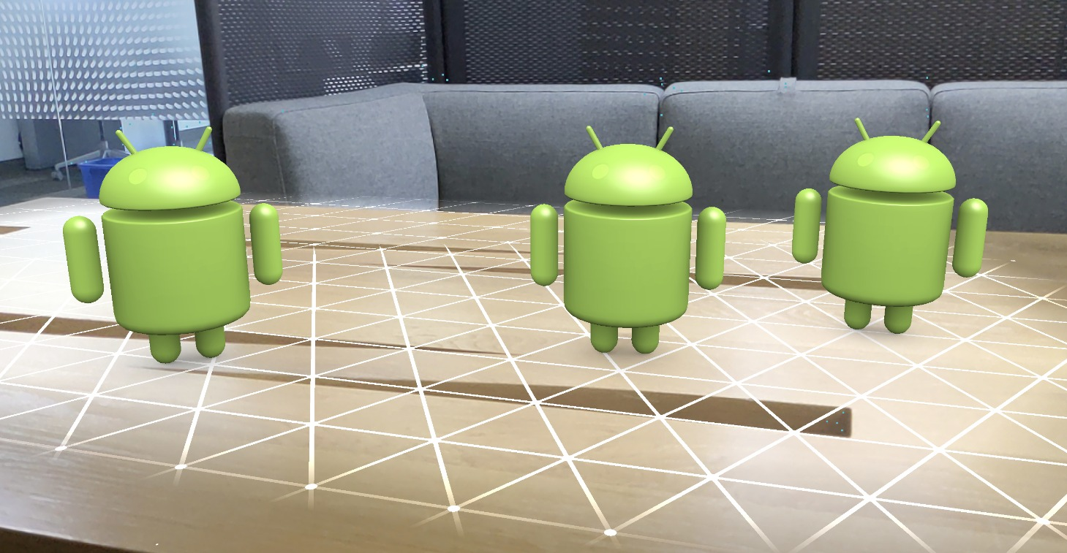
텍스쳐 입히기
public void draw(float dt) { …
GLES20.glActiveTexture(GLES20.GL_TEXTURE0); GLES20.glBindTexture(GLES20.GL_TEXTURE_2D, textures[0]); pos = GLES20.glGetUniformLocation(program, "tex"); GLES20.glUniform1i(pos, GLES20.GL_TEXTURE0); … }
public class Background { int[] textures = new int[1];
…
private final String fscode = "precision mediump float;" + "uniform sampler2D tex;" + "varying vec2 tc;" + "void main() {" + " gl_FragColor = texture2D(tex, tc);" + "}";
public Background(Context context) { …
GLES20.glGenTextures(1, textures, 0); Bitmap texBitmap = BitmapFactory.decodeStream(context.getAssets().open("frame1.png")); GLES20.glBindTexture(GLES20.GL_TEXTURE_2D, textures[0]); GLUtils.texImage2D(GLES20.GL_TEXTURE_2D, 0, texBitmap, 0); GLES20.glTexParameteri(GLES20.GL_TEXTURE_2D, GLES20.GL_TEXTURE_WRAP_S, GLES20.GL_CLAMP_TO_EDGE); GLES20.glTexParameteri(GLES20.GL_TEXTURE_2D, GLES20.GL_TEXTURE_WRAP_T, GLES20.GL_CLAMP_TO_EDGE); GLES20.glTexParameteri(GLES20.GL_TEXTURE_2D, GLES20.GL_TEXTURE_MIN_FILTER, GLES20.GL_LINEAR); GLES20.glTexParameteri(GLES20.GL_TEXTURE_2D, GLES20.GL_TEXTURE_MAG_FILTER, GLES20.GL_LINEAR); GLES20.glBindTexture(GLES20.GL_TEXTURE_2D, 0); }

Slide 17
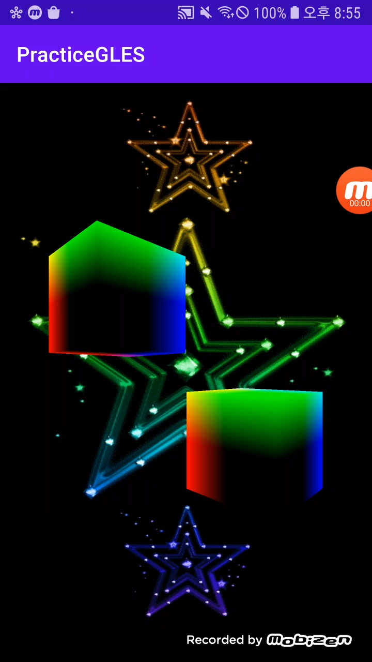
연습용 문제 1
힌트 – vertex buffer 건들이지 않고도, 그냥 두 번 그리면 두개가 그려짐
그대로 두개 그리면 겹쳐서 안보일테니 modelMX만 살짝 바꿔서 시도
방향이 다른 두개 그려보기
추가로 각각 다른 방향으로 회전하는 것도 만들어보기

Slide 18
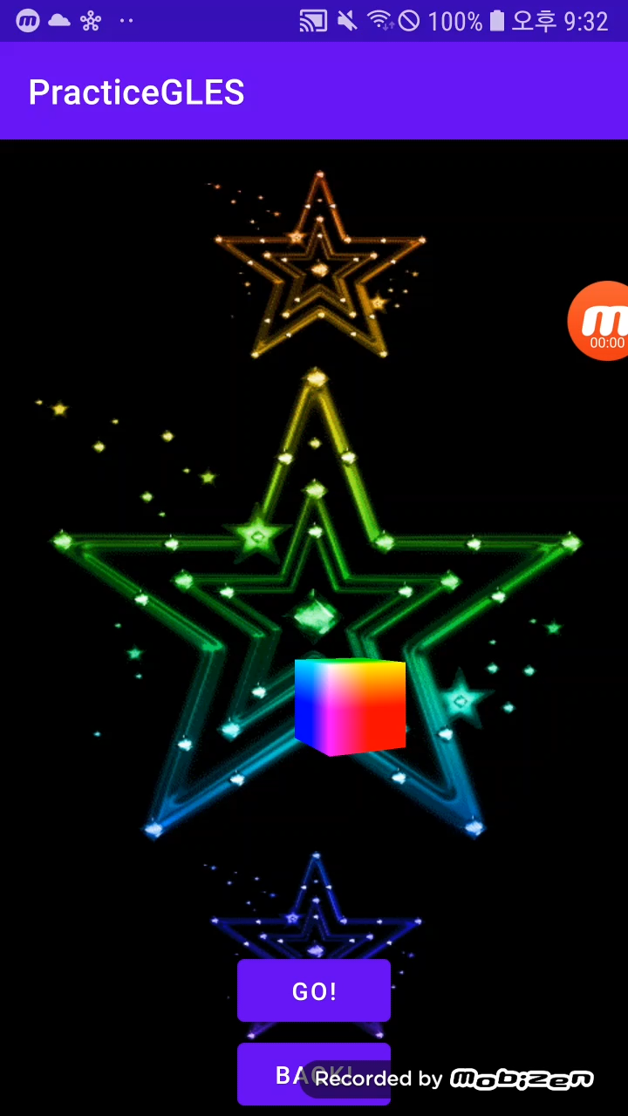
연습용 문제 2-1
<LinearLayout android:layout_width="wrap_content" android:layout_height="wrap_content" android:layout_alignParentBottom="true" android:layout_centerHorizontal="true" android:orientation="vertical"> <Button android:id="@+id/go" android:layout_width="wrap_content" android:layout_height="wrap_content" android:text="Go!" /> <Button android:id="@+id/back" android:layout_width="wrap_content" android:layout_height="wrap_content" android:text="Back!" />
<activity_main.xml>
에 추가
<MainActivity.java - onCreate>
public class MainActivity extends AppCompatActivity implements GLSurfaceView.Renderer { … Button goButton, backButton; @Override protected void onCreate(Bundle savedInstanceState) { … goButton = (Button) findViewById(R.id.go); goButton.setOnClickListener(l -> { ? }); backButton = (Button) findViewById(R.id.back); backButton.setOnClickListener(l -> { ? }); }
(eye와 center을 class 멤버로 둘것)
앞뒤로 가는 버튼 만들기
확대되는게 아니라 눈의 위치가 중심 방향으로 다가가는 것

Slide 19
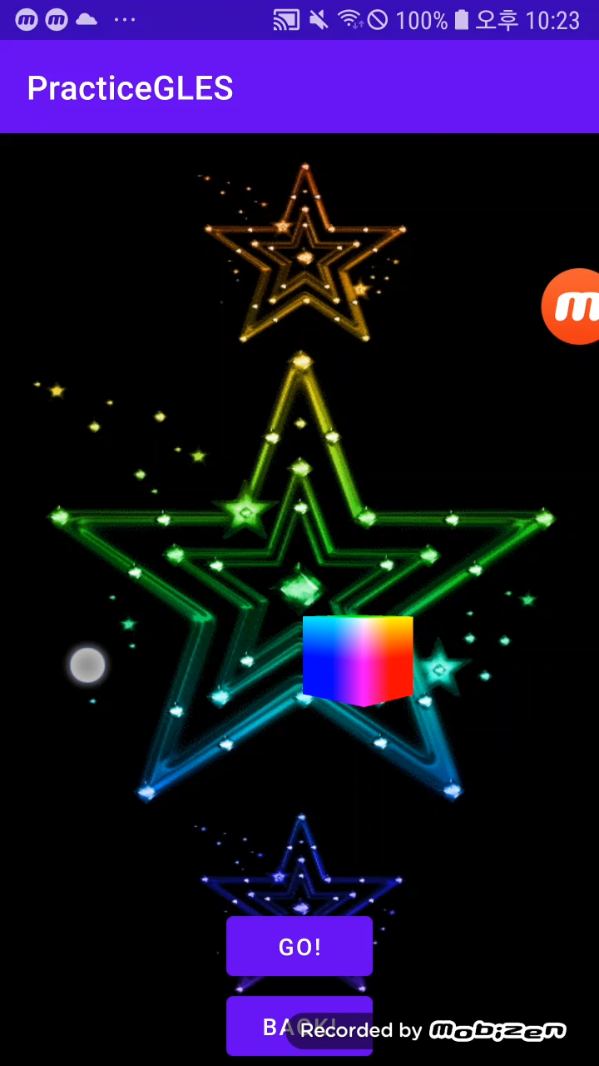
연습용 문제 2-2
< Cube.java>
public class Cube {
…
float eyeX = 0.0f, eyeY = 0.0f, eyeZ = 3.0f; float centerX = 0.0f, centerY = 0.0f, centerZ = -1.0f; float theta = 0.0f, lastX = 0.0f; public void changeDir(float newX) { ? }
… }
<MainActivity.java - onCreate>
glView.setOnTouchListener((view, event) -> { if (event.getAction() == MotionEvent.ACTION_DOWN) { cube.lastX = event.getX(); return true; } if (event.getAction() == MotionEvent.ACTION_MOVE) { cube.changeDir(event.getX()); return true; } return false; });
터치 모션으로 좌우로 보는 방향(center)을 바꿀 수 있도록

Slide 20
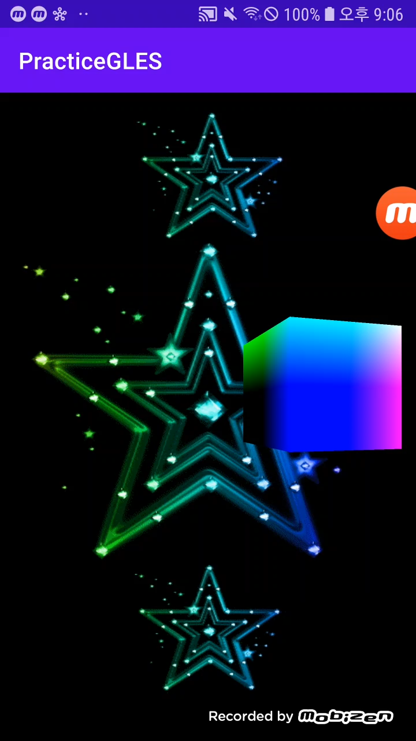
연습용 문제 3
힌트 – 텍스쳐 3개 gen 하고 시간에 따라 다른 텍스쳐 bind
텍스쳐 3개 이용해 쿵짝거리게 만들어보기

